Slide 1

SEQUENCE & SERIES

Slide 2
DIFFERENT TYPES OF SERIES
Type | Pattern Example | Explanation
Arithmetic Series | 5, 10, 15, 20, ? | Add same number each time (+5)
Geometric Series | 2, 4, 8, 16, ? | Multiply by same number each time (×2)
Fibonacci Series | 0, 1, 1, 2, 3, 5, 8, ? | Sum of previous two numbers
Square/Cube Series | 1, 4, 9, 16, 25, ? | Squares: 1², 2², 3²…
Alternate Patterns | 2, 4, 6, 9, 11, 13, ? | Different logic for odd/even positions
Difference Series | 3, 8, 15, 24, 35, ? | Differences: +5, +7, +9, +11…
Mixed Operations | 2, 5, 10, 17, 26, ? | Add 3, 5, 7, 9... (increasing additions)
Letter Series | A, C, E, G, ? | Skip one letter

Slide 3
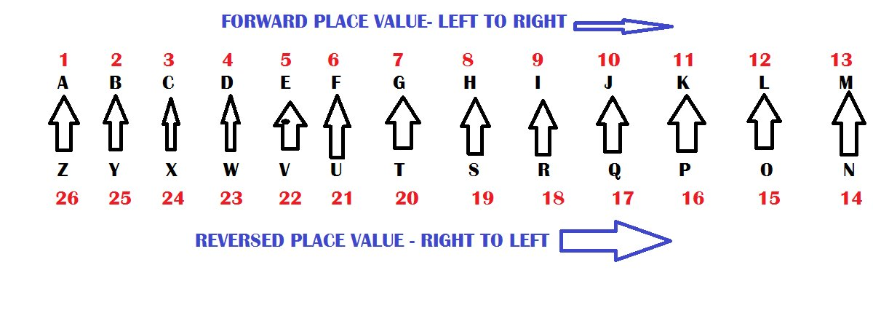

Slide 4
1. 144, 196, 256, 324, 400, 484, _____ (1) 529 (2) 576 (3) 625 (4) 784 (5) 676
2. 27, 125, 343, 729, _____ (1) 1000 (2) 1728 (3) 121 (4) 1031 (5) 1331
3. 11, 22, 34, 47, 61, 76, _____ (1) 82 (2) 86 (3) 94 (4) 92 (5) 88
4. 11, 22, 35, 52, 71, 94, _____ (1) 123 (2) 115 (3) 129 (4) 117 (5) 131
5. 11, 12, 16, 25, 41, 66, _____ (1) 92 (2) 94 (3) 106 (4) 108 (5) 102

Slide 5
6. 11, 12, 20, 47, 111, _____ (1) 222 (2) 214 (3) 236 (4) 244 (5) 226
7. 1, 2, 6, 24, 120, _____ (1) 680 (2) 720 (3) 780 (4) 560 (5) 640
8. 1, 2, 6, 30, 210, _____ (1) 1890 (2) 1640 (3) 1820 (4) 2400 (5) 2310
9. 36, 18, 18, 27, 54, 135, _____ (1) 415 (2) 385 (3) 365 (4) 405 (5) 425
10. 1, 2, 6, 21, 88, _____ (1) 425 (2) 445 (3) 385 (4) 405 (5) 545

Slide 6
11. BV, CU, ES, HP, LL, QG, _____ (1) VB (2) WB (3) WA (4) VC (5) WC
12. PLD, QJG, RHJ, SFM, TDP, _____ (1) UCR (2) UDT (3) UBR (4) UBS (5) UBU
13. BRDY, CPGU, DNJQ, ELMM, _____ (1) FKQJ (2) FHRI (3) FJPI (4) FRJH (5) FIQJ

Slide 7
Arithmetic progression/series
Concept | Description / Formula | Example
Definition | A sequence where the difference between consecutive terms is constant | 3, 7, 11, 15, …
First Term (a) | The first number in the sequence | a = 3
Common Difference (d) | The fixed difference between terms | d = 7 – 3 = 4
General Term (Tₙ) | Tn=a+(n−1)d | T₅ = 3 + (5 – 1)×4 = 19
Sum of n Terms (Sₙ) | Sn=n/2[2a+(n−1)d] or Sn=n/2(first term + last term) | S₅ = 5/2 × (2×3 + 4×4) = 55

Slide 8


Geometric progression/series
Concept | Description / Formula | Example
Definition | A sequence where each term is obtained by multiplying the previous term by a fixed number (common ratio) | 2, 4, 8, 16, …
First Term (a) | The first number in the sequence | a = 2
Common Ratio (r) | The factor between consecutive terms | r = 4 ÷ 2 = 2
General Term (Tₙ) |  | T₄ = 2 × 2³ = 16
Sum of First n Terms (Sₙ) |  | S₄ = (2(2⁴ – 1))/(2 – 1) = (2×15)/1 = 30

Slide 9
A) 49
A) 10
3. If the sum of the first 10 terms of an AP is 155, and the first term is 5, what is the common difference?
1. What is the 15th term of the AP: 7, 10, 13, ...?
B) 51
C) 51
D) 52
2. The 5th term of an AP is 22 and the 11th term is 40. What is the first term?
B) 12
C) 8
D) 6
A) 3
B) 2
C) 1.5
D) 4

Slide 10
A) 162
A) 45
5. Find the 5th term of the GP: 2, 6, 18, ...
B) 54
C) 486
D) 108
6. In a GP, the first term is 3 and the common ratio is 2. Find the sum of the first 4 terms.
B) 48
C) 30
D) 42

